Slide 1
Layering and Sockets
CS 168 - Spring 2020 - Dis 2

Slide 2
Agenda
Terms
Poking the Internet
Layering
Sockets
Establishing connections
Send and receive

Slide 3
Terms
Network Stack: networking software on host.
Some router/switch functions
+ extra processing before passing packets to applications
Packets: a grouping of bits:
Header: useful info for network and network stack decisions
Body / payload: data to transfer (file, image, application header, ...)
Not useful to network
Routers / Switches:
Devices that forward packets (between links)
We make no distinction between routers/switches at this point
Naming:
Network address: where host is located
Network name: which host it is
When you move a server to a new building, its name does not change but its address does
Notes:
FEEL FREE TO CUSTOMIZE THESE TWO SLIDES IN YOUR OWN VERSION
Network
- Routers/Switches and links
Network Stack
- Networking SW on host. It replicates some routers/switch functionality then adds some additional network functionality before giving packet to application
Packets
- bags of bits. Consists of:
- Header w/meaningful info for network and network stack to make decisions
- Body containing a payload. Ex. A file, imagine, an application header, etc.
Routers/Switches
- devices that take a packet arriving on one of its incoming communication links and forwards said packet on one of its outgoing links. We make no distinction between routers/switches at this point because the difference is subtle
Application
- Most high level part of network connection, responsible for sending and receiving data as well as understanding the content of the data
Port:
- In routing context in the network, this refers to a physical port, which is responsible for providing a connection between routers/switches.
- In network stack and application context, this could be a logical port which is a means of which an application can connect to the network stack. (More on ports later in the semester)
Socket
- OS mechanism that connects processes to network stack via (logical) ports. More on this later..
Naming
- Network address: where host is located
- Network name: which host it is
- When you move a server to a new building, it’s name does not change but it’s address does
Internet Service Provider (ISP)
- Essentially an ISP is in itself a network of packet switches and communication links providing network access to end systems/links
Autonomous Systems (ASes)
- A group of routers that are under the same administrative control.
- Often routers in an ISP and the links that interconnect them constitute a single AS; however, some ISPs partition their network into multiple ASes
- Routers within the same AS will run the same routing algorithm and have information about each other
Routing table
- Table used by routers/switches to determine which outgoing link (port) to send a packet
Control plane
- mechanisms used to computer touting tables. i.e. concerned with determining/creating routing decisions
Data plane
- Using said tables to actually forward packets. i.e. concerned with the actual semantics/performance of forwarding packets
Circuit Switching
- method of data transfer in which an end system reserves BW along a path - sets up a circuit - for communication. No need for packets.
Packet Switching
- method of data transfer in which routers/switches service each packet they receive independently by inspecting its header

Slide 4
Terms (cont’d)
Routing Table: used by routers/switches to determine which outgoing link (port) to send a packet
Control Plane: system that computes routing tables (decides routing)
Data Plane: system that actually forwards packets (using routing tables)
Concerned with actual semantics/performance of forwarding packets
ISP (Internet Service Provider): an org / company that provides network access to end users (i.e. Comcast, Sonic)
ASes (Autonomous Systems): groups of routers under the same control
Usually each ISP has an AS, but may have multiple ASes
Routers within the same AS will have information about each other
Notes:
Network
- Routers/Switches and links
Network Stack
- Networking SW on host. It replicates some routers/switch functionality then adds some additional network functionality before giving packet to application
Packets
- bags of bits. Consists of:
- Header w/meaningful info for network and network stack to make decisions
- Body containing a payload. Ex. A file, imagine, an application header, etc.
Routers/Switches
- devices that take a packet arriving on one of its incoming communication links and forwards said packet on one of its outgoing links. We make no distinction between routers/switches at this point because the difference is subtle
Application
- Most high level part of network connection, responsible for sending and receiving data as well as understanding the content of the data
Port:
- In routing context in the network, this refers to a physical port, which is responsible for providing a connection between routers/switches.
- In network stack and application context, this could be a logical port which is a means of which an application can connect to the network stack. (More on ports later in the semester)
Socket
- OS mechanism that connects processes to network stack via (logical) ports. More on this later..
Naming
- Network address: where host is located
- Network name: which host it is
- When you move a server to a new building, it’s name does not change but it’s address does
Internet Service Provider (ISP)
- Essentially an ISP is in itself a network of packet switches and communication links providing network access to end systems/links
Autonomous Systems (ASes)
- A group of routers that are under the same administrative control.
- Often routers in an ISP and the links that interconnect them constitute a single AS; however, some ISPs partition their network into multiple ASes
- Routers within the same AS will run the same routing algorithm and have information about each other
Routing table
- Table used by routers/switches to determine which outgoing link (port) to send a packet
Control plane
- mechanisms used to computer touting tables. i.e. concerned with determining/creating routing decisions
Data plane
- Using said tables to actually forward packets. i.e. concerned with the actual semantics/performance of forwarding packets
Circuit Switching
- method of data transfer in which an end system reserves BW along a path - sets up a circuit - for communication. No need for packets.
Packet Switching
- method of data transfer in which routers/switches service each packet they receive independently by inspecting its header

Slide 5
Poking the Internet

Slide 6
Ping, Traceroute
These tools can give some insight into what is going on inside and across the internet.
We’re going to play around with them a little bit

Slide 7
Ping, Traceroute
Ping is a simple utility that basically lets you poke a website and see if it moves (spoiler: most do!)
You say hi and see if the server says hi back
This by itself is not super interesting
Ping also tells you how long the reply took to come back
This is more interesting!
Let’s try out a few websites.
Notes:
Instructions on Next slide!

Slide 8
Ping: A prediction
We’ve pinged a couple websites and seen pretty significant differences in latency.
Latency is the time between when a request is sent and when the response is heard.
What about differences in latency for the same website, but in different regions?
We’ve pinged google.com and seen its latency.
How many times longer will it take for a ping to google.co.uk to come back?
Notes:
Command: ping <website>
If you add “-4” in windows, it will force IPv4
Websites: Berkeley (berkeley.edu), Google, Github, Microsoft (no response), zu.ac.tz (Zanzibar University Login), allspice.lcs.mit.edu, www.vutbr.cz (Brno University, Czech Republic)
Ping google.co.uk at the end
It should take about the same time to ping google.co.uk as google.com => google is smart enough to configure their DNS entries to allow anycast to work well across TLDs
It also has a CDN, the ping for google.com and google.co.uk goes into the same POP

Slide 9
Ping, Traceroute
Does what its name implies: it allows you to trace the route that packets take from your computer to the destination.
Specifically lets you see the routers/switches that are forwarding your packets.
Packets have a limit to how many times they can be forwarded
Dropped when the limit is exceeded
Prevents a packet from looping and other issues. We will come back to this later.
Most routers will notify the sender when the packet is dropped
Traceroute sets the limit to 1,2,3,… for the same destination
Allows sender to trace the path of the packet
Demo
Notes:
“How?” section moved to bonus slides, can discuss at end of section if students are curious.
Command(linux, macOS): traceroute <website>
Command(Windows) tracert <website>
Websites: Berkeley, Google, Github, Microsoft (no response), zu.ac.tz, allspice.lcs.mit.edu, www.vutbr.cz
-Feel free to also try eecs.berkeley.edu (it has a much different traceroute)
NOTE: CENIC = Corporation for Education Network Initiatives in California (Powerful networks for CA Univerisites)

Slide 10
Traceroute: Notice anything?
Traceroute gives us a lot more interesting feedback than ping.
Latency to every step along the way.
Can see a breakdown of latencies!
Router names.
Often have locations in them (i.e. city name)
Can roughly trace packet path on a map!
Multiple routers at a given step!?
Traffic engineering, load balancing, route changes!
Weird stars
Some routers just don’t respond ⁻\_(ツ)_/⁻
Notes:
Stars may also mean that it timed out

Slide 11
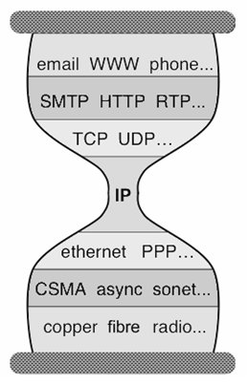
Layering
Applications
…built on…
Reliable (or unreliable) transport
…built on…
Best-effort global packet delivery
…built on…
Best-effort local packet delivery
…built on…
Physical transfer of bits

Slide 12
Layering
L7: Application
do the thing
L6: Presentation
(ignored here)
L5: Session
(ignored here)
L4: Transport
beyond delivery: (un)reliability, packet assembly, congestion control, ...
L3: Network
global delivery, best-effort
L2: Data link
local delivery, best-effort
L1: Physical
physical transfer of bits

Slide 13
Layering in practice
L7: Application
HTTP(S)
SSH
Email (IMAP/POP)
...
L6: Presentation
L5: Session
L4: Transport
TCP
UDP
L3.5: research!
L3: Network
IP
L2.5: MPLS
L2: Data link
Ethernet
802.11 Wi-Fi
CAN bus
USB
L1: Physical

Slide 14
Sockets
Developed here, at UC Berkeley!
OS abstraction for connections
Allow L7 applications to operate on data streams (not packets)
Connect, listen, accept, send, receive
Open a socket between:
Source IP address : port
Destination IP address : port
Notes:
Split info into two slides (and add picture)

Slide 15
Connection (the basic abstraction)
Pipes data between two processes (on different hosts)
Data flows both ways!
The Internet
Process
Process
Connection

Slide 16
Connection (the basic abstraction)
Data is sent simply as a stream of bits
Reconstruction of bits only at the endpoints
The Internet knows nothing* about what it’s transmitting!
* (unless you’re implementing security)
The Internet
Process
Process
Connection
Notes:
*** security

Slide 17
Socket API
Establish Connection
Sending
Receiving
The Internet
Process
Process
Connection

Slide 18
Connections
Client
Client
Two types of sockets
Server and Client
Servers listen for clients to connect to them
Wait until a connection is attempted
Accept and dispatch connection
Usually serving many clients at once
Clients initiate new connections to servers
Example
Server: berkeley.edu
Client: Your internet browser
Server
Client
Client

Slide 19
Connections
1.2.3.4
5.6.7.8
Client
Client
Hosts have addresses
Unique identifier (just like a street address)
Clients (different users) find servers with their addresses
Servers send data back with the client address
Example addresses ➔
10.20.30.40
Server
9.10.11.12
13.14.15.16
Are addresses enough to make this work?
Client
Client

Slide 20
Address aren’t enough
How does the client computer know which process (i.e. web browser) to deliver data to?
Client Machine (1.2.3.4)
Server
Process 1
Process 2

Slide 21
Ports
Server Machine
Client Machine (1.2.3.4)
Process 1
(Port 80)
Process 1
(Port 10000)
Sockets are identified by unique IP:port pairs
A port is a number that the OS associates with a socket when it is created
Used in the address to tell which port socket is listening on
i.e. sending to address “1.2.3.4:10000” would send data to the socket owned by Process 1
Process 2
(Port 20000)

Slide 22
Ports
Server Machine
Client Machine (1.2.3.4)
Process 1
(Port 80)
Process 1
(Port 10000)
Packets carry port number
Servers listen on a port
Which one depends on application
HTTP: 80
SSH: 22
Client process connects to
well known port
Client also has a port
Randomly assigned by OS
Used by OS to send data to correct process
Process 2
(Port 20000)

Slide 23
Socket Mechanics
Process
Send buffer
Filled by process
Drained by network
Bits wait to be transmitted by network
Receive buffer
Filled by network
Drained by process
Bits wait to be read by process
Why two buffers?
Network

Slide 24
Socket Mechanics: Full or Empty
Process
What if you write to a full socket buffer or read from an empty one?
Two solutions:
Blocking (wait)
Non-blocking (return error)
We’ll talk about blocking briefly.
Network

Slide 25
Socket Mechanics: Blocking Write
Process
Try to write, but buffer is full
Block (wait) until there is enough room in the buffer
Write the data and return
Network

Slide 26
Socket Mechanics: Blocking Read
Process
Try to read, but buffer is empty
Block (wait) until some bits appear in the buffer
Read the bits and return them
Network

Slide 27
Socket Mechanics: Non Blocking
Non blocking reads and writes behave differently
If the buffer isn’t ready for the operation
Just return an error
The user must try again later

Slide 28
Discussion: Which is better, blocking or non-blocking?
Notes:
Spoiler alert: it depends.

Slide 29
Sockets: Python API
https://docs.python.org/2/howto/sockets.html

Slide 30
Connection Establishment: Server
Create a socket:
server_socket = socket.socket()
Bind the socket to listen on an IP:port address
server_socket.bind((“0.0.0.0”, 12345))
Usually use “127.0.0.1” (“loopback”: only on local machine) or “0.0.0.0” (all host addresses)
Listen for new connections
server_socket.listen(5); up to 5 connections may wait in queue
Process incoming connection request
(new_socket, address) = server_socket.accept()
new_socket now can send to and receive from the client

Slide 31
Connection Establishment: Client
Create a socket:
client_socket = socket.socket()
Connect to server IP “1.2.3.4” on port 80
client_socket.connect((“1.2.3.4”, 80))
Socket is now ready to send and receive.
You can find more socket methods here: https://docs.python.org/2/library/socket.html

Slide 32
Send and Receive
send(str)
Take some bits in as an argument, and add them to the send buffer
recv(size)
Read at most size bytes from the receive buffer

Slide 33
Bonus Slides

Slide 34
Ping, Traceroute, Dig
Traceroute gives you the path of routers and switches your packets take.
How?
Takes advantage of something called a TTL in the packet IP header.
TTL denotes how many times a packet should be forwarded before it is discarded.
Why does this exist?
To stop the internet from collapsing! (We’ll cover this when we get to routing)
Sets the TTL to 1, 2, 3, etc
When packets are dropped because of TTL expiring, most routers send back a message telling us.
Use the source of this notification to identify the routers along the packet’s path.

Slide 35
Old slides

Slide 36
Dig: A breakdown
When using the +trace option, there was a lot more information
We could see the steps that were taken when resolving the names
First, the ‘root’ servers were queried
Then, the TLD (top level domain) server was queried
After that, successive servers were asked until the IP was found
More on how this works when we discuss DNS

Slide 37
Python Script for socket connection
Server on localhost:12345
Run in python2.7
Copy and Paste the entire Speakers note section
Notes:
import socket, sys, threading
###If it doesn't work because it's been run recently, update the port number below
port = 12345
####
def client():
client_socket = socket.socket()
client_socket.connect(("127.0.0.1", port))
while True:
client_socket.send("hello")
def server():
server_socket = socket.socket()
server_socket.bind(("0.0.0.0", port))
server_socket.listen(5)
while True:
(new_socket, _) = server_socket.accept()
new_socket.send("Hello")
def main():
clientThread = threading.Thread(target=client).start()
serverThread = threading.Thread(target=server).start()
while True:
try:
pass
except KeyboardInterrupt:
clientThread.exit()
serverThread.exit()
sys.exit(0)
main()
##Close window!

Slide 38
Emergency Screenshots
Notes:
This is in case Latencies and similar are really weird OR the internet (Airbears )breaks
Also useful to know what to look for

Slide 39
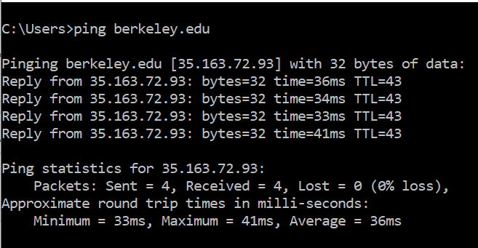
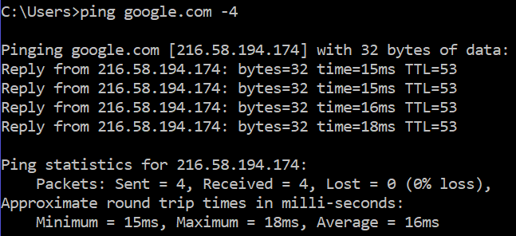
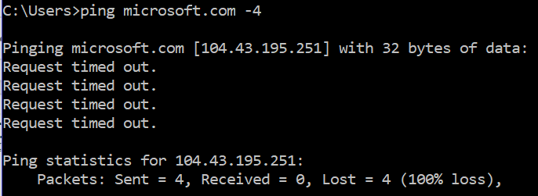
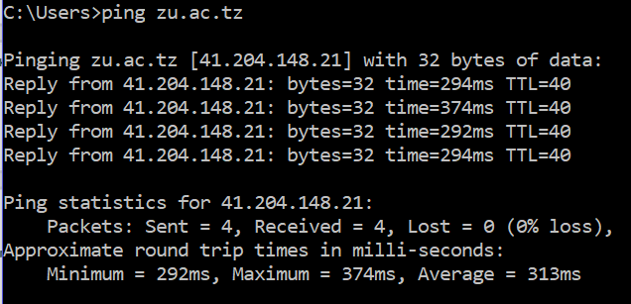
Notes:
These are Berkeley, Google, Microsoft and Zanzibar University
Note that Berkeley and google have relatively low RTTs, while Zanzibar has a really long RTT
I pinged from OUTSIDE Berkeley’s Network
Microsoft.com does not respond to pings
Google.co.uk is on the NEXT page

Slide 40
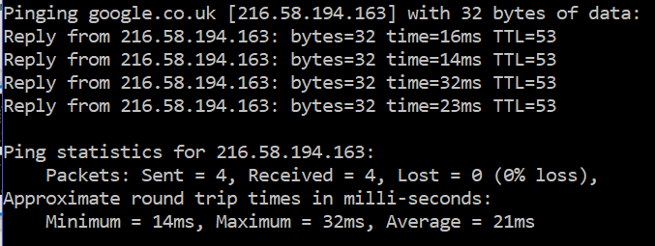
Notes:
Note that the RTT is similar to google.com on the previous slide

Slide 41
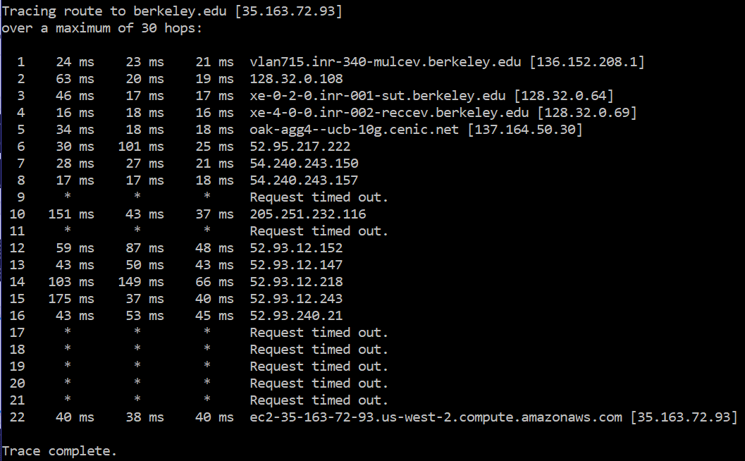
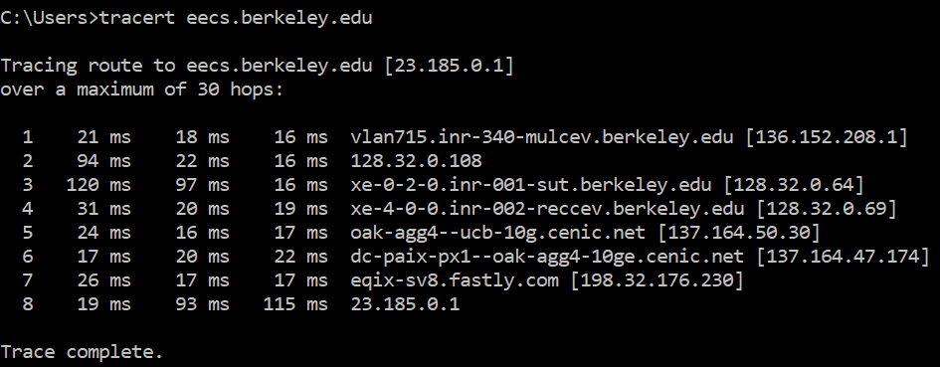
Notes:
Hosted at different places

Slide 42
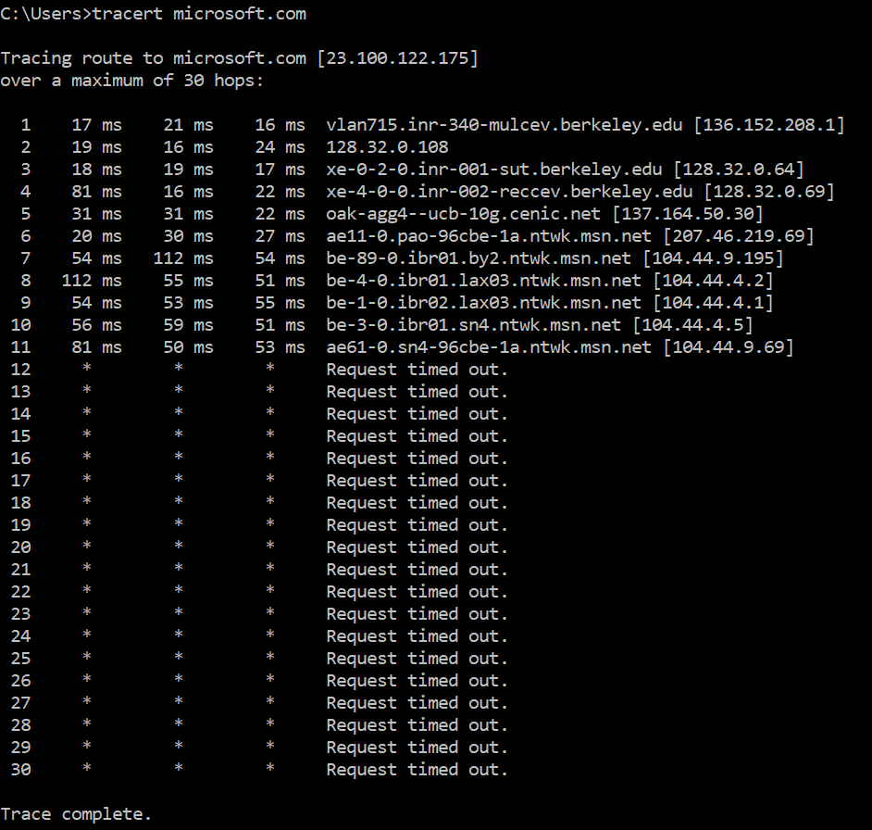
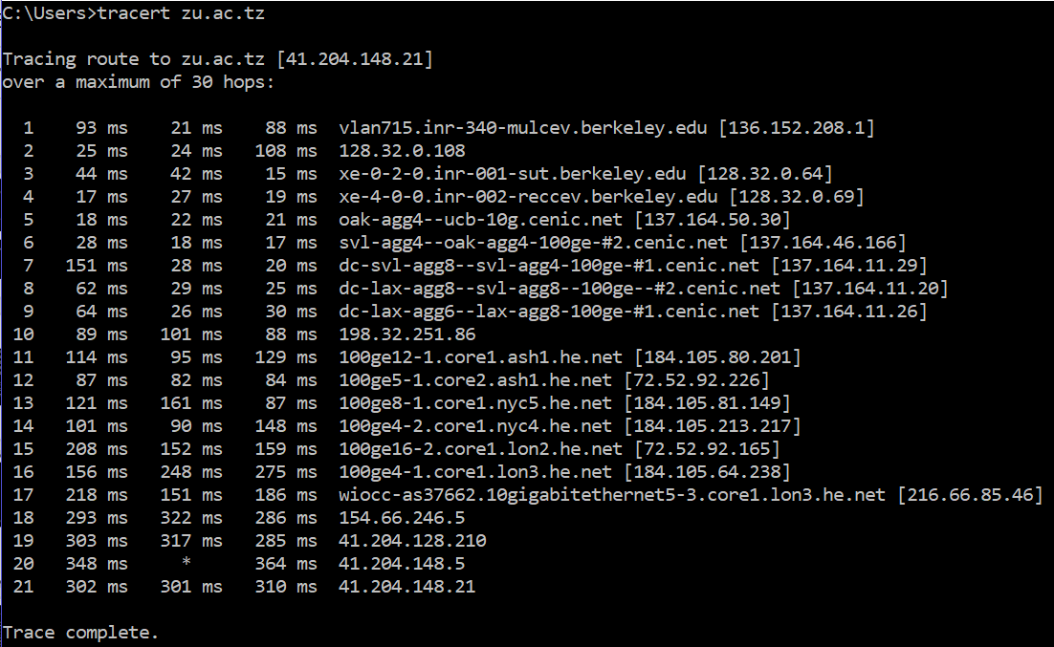
Notes:
Zanzibar is geographically farther than microsoft, but has less routers in-between

Slide 43
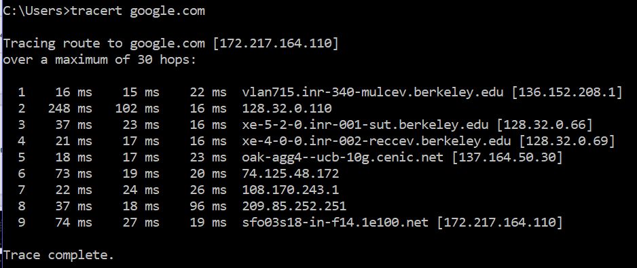
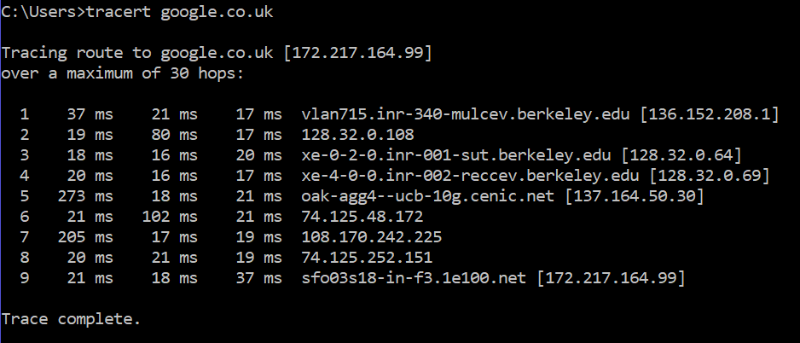
Notes:
Notice that both google traceroutes resolve to the same end location in SF
Paths differ a little bit (exact routers and IP addresses)

Slide 44
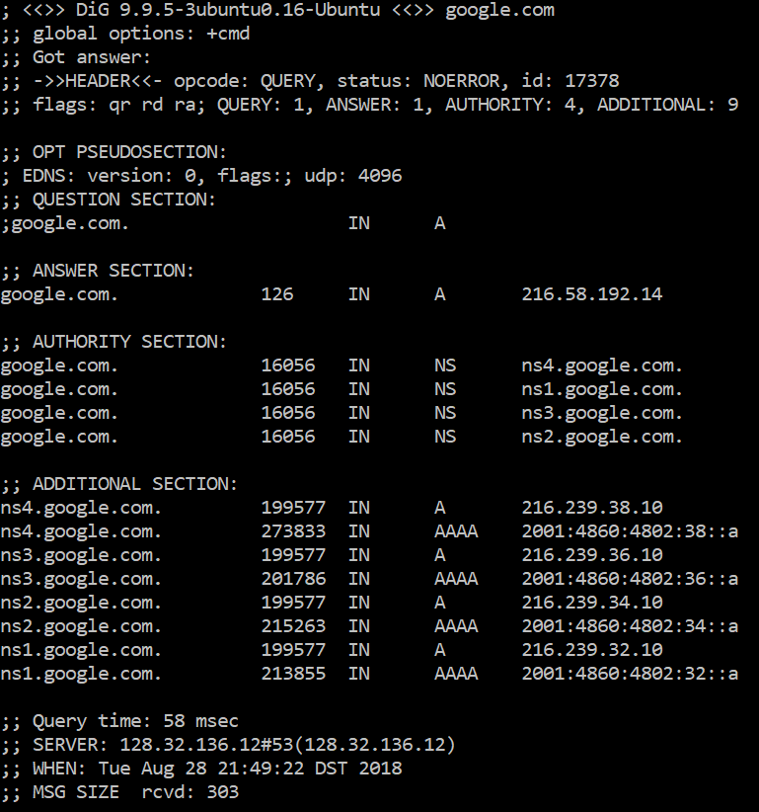
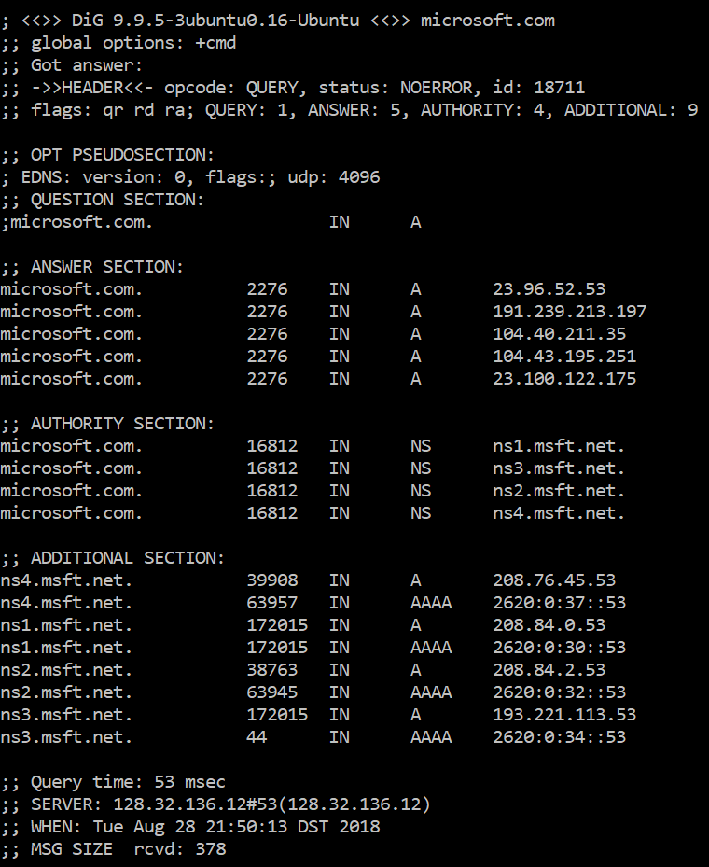
Notes:
Dig for google and microsoft

Slide 45
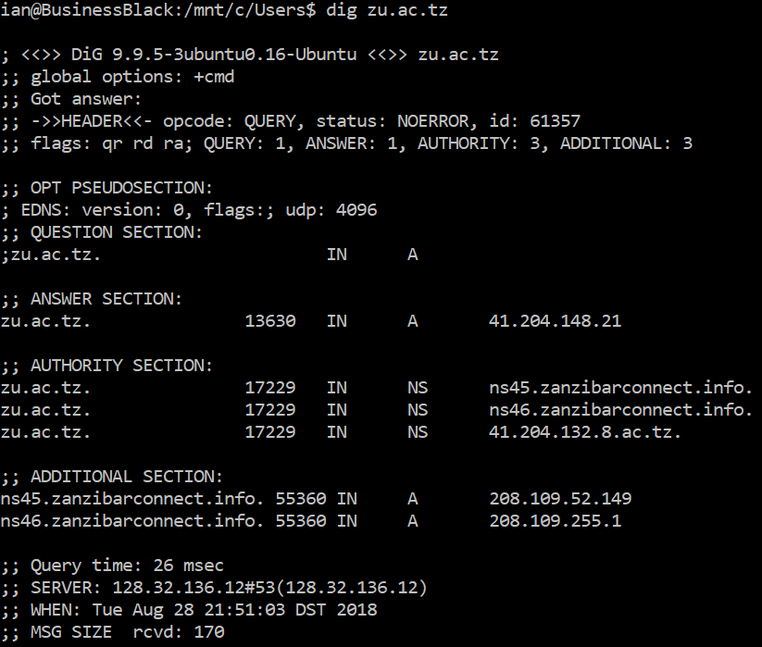
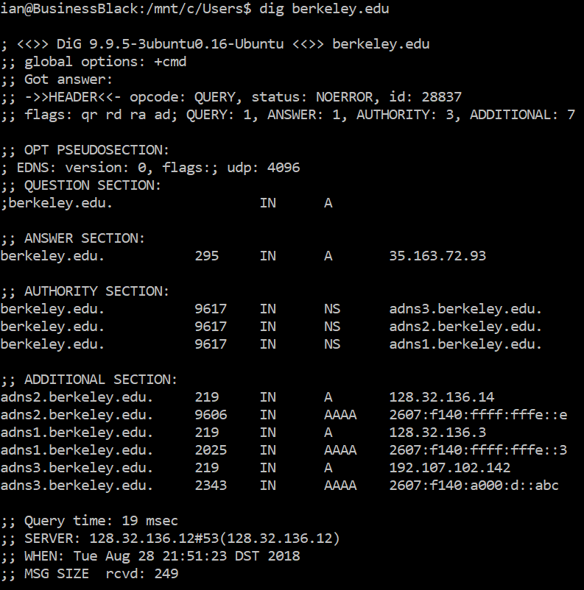
Notes:
Zanzibar and berkeley

Slide 46
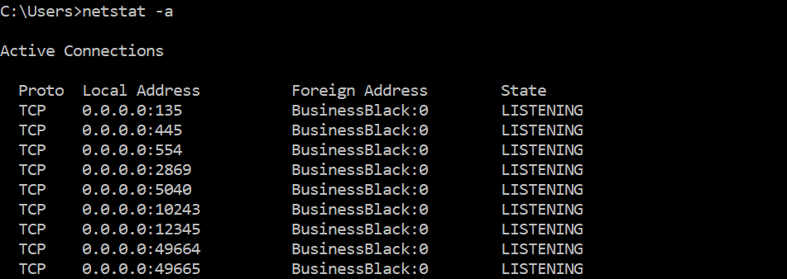
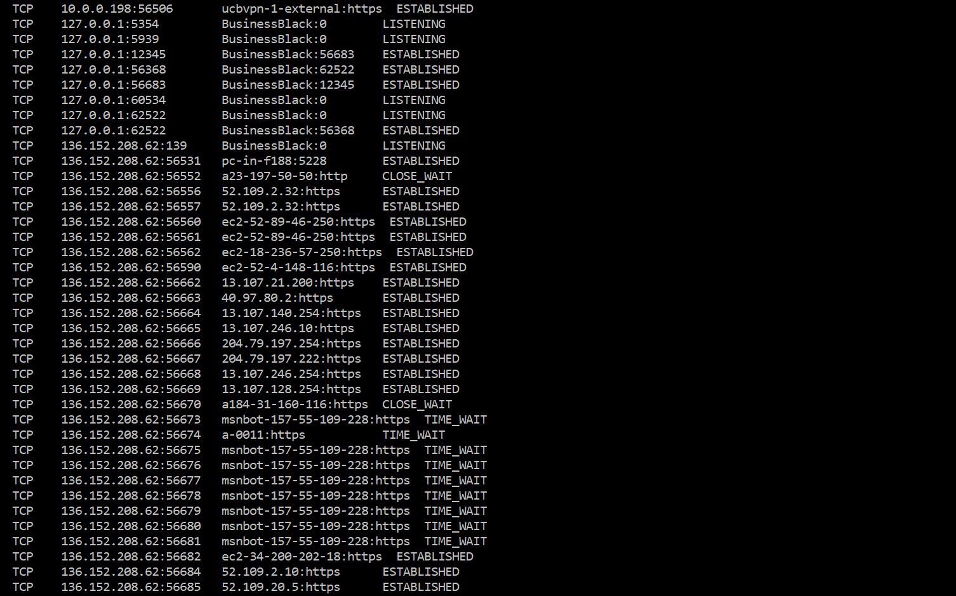
Notes:
Netstat (with some explanations)
--and some nice highlights
--and removing some entries (I removed all UDP entries that are below)
BTW: My computer’s hostname is “BusinessBlack”
First few are MS-Windows related
0.0.0.0:12345 is the python server listening for incoming connections
LISTENING = These ports are listening for an incoming connection (acting more like a server)
127.0.0.1:12345 to BusinessBlack:56683 (and vice versa) are the active connections from client to and from the server
The connections to 52.109.2.32 https are connections for Office.com (probably my onenote notebook)

Slide 47
Notes:
Msnbot is the notification services for various windows apps
40.97.80.2
ESTABLISHED = Ongoing connection
CLOSE_WAIT = Other side closed
TIME_WAIT = This side closed
//Details of TCP that come up later :)

